Slide 1
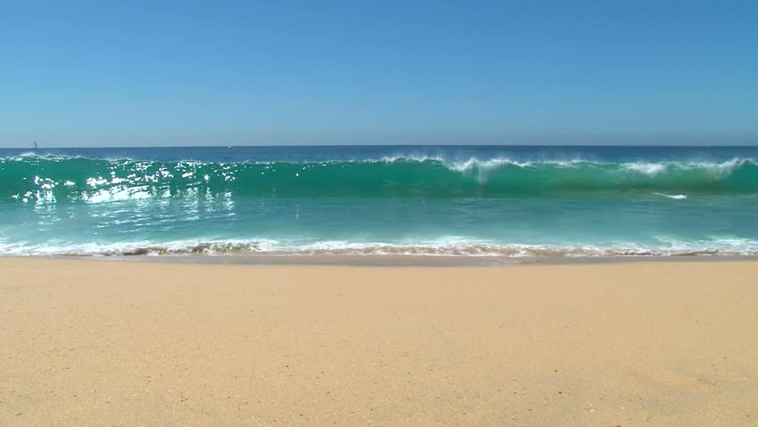
Life Beyond extreme
Dr. S. Vijayanand,
Assistant Professor,
BRT lab, Department of Biotechnology,
Thiruvalluvar University
Serkkadu, Vellore 632 115
Mail Id: vipni76@tvu.edu.in

Slide 2
Bioresource Technology
Technology that deals with the utilizations of substance from biological origin for the development of science and technology
It widely covers all areas concerning biomass, biological waste treatment, bioenergy, biotransformation and Bioresource system analysis and technologies associated with conversion or production

Slide 3
Pharmacological
Food and Feed
Agriculture
Bioresource Technology
Bioenergy
Cosmetic

Slide 4
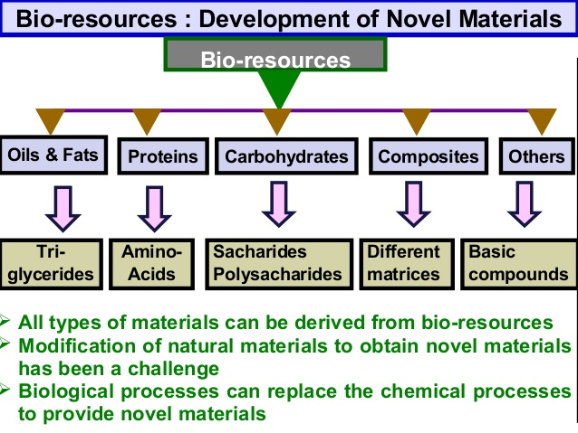

Slide 5
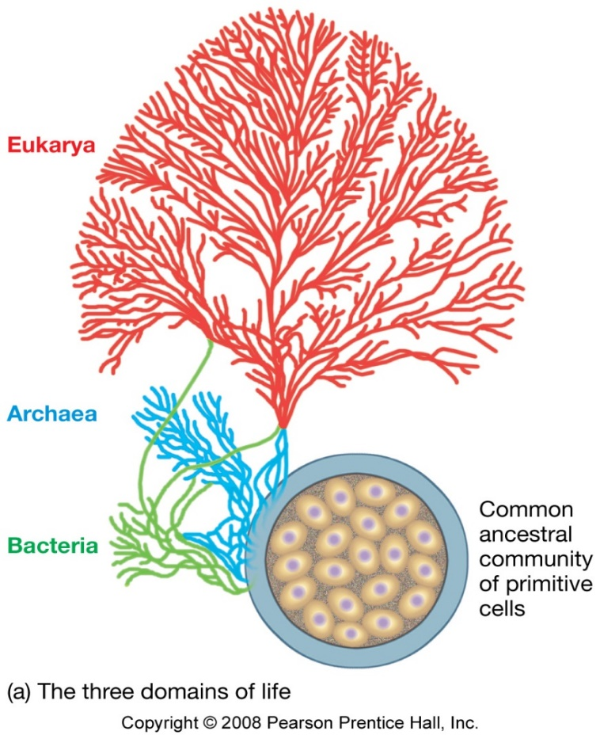
Three domains of Life
Archaea
Prokaryotic, includes “extremophile” bacteria
Bacteria
Prokaryotic, includes what used to be in Kingdom Monera
Eukarya
Eukaryotic cells
Includes Protists, Fungi, Plants, and Animals

Slide 6
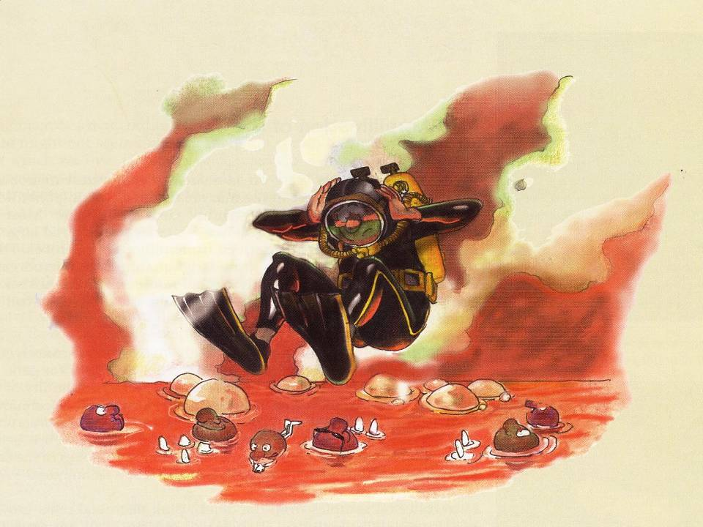
Life under extremes

Slide 7
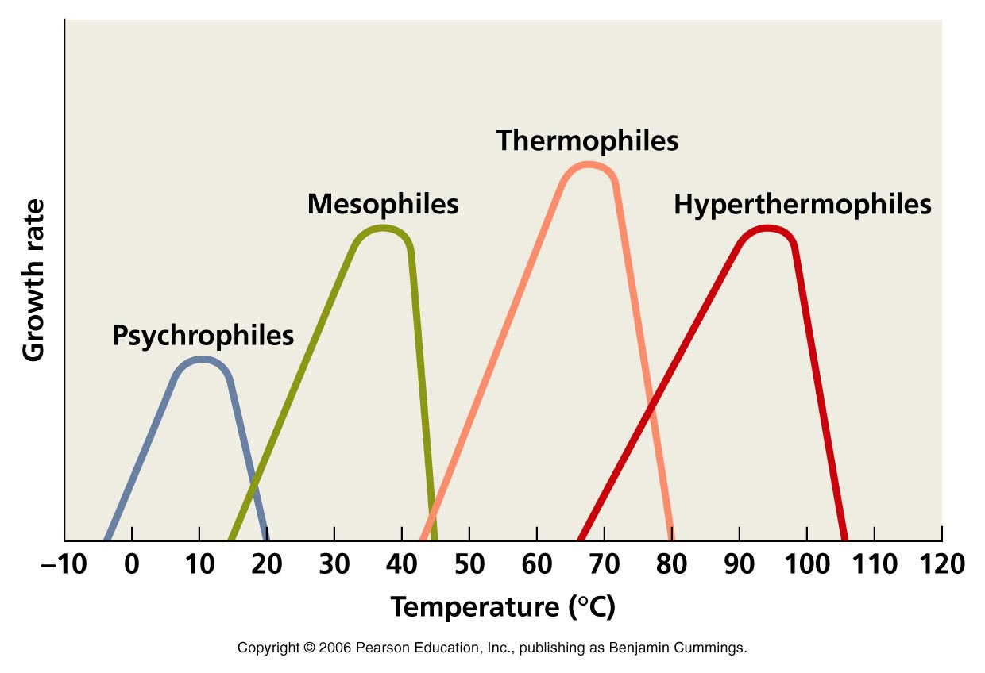

Slide 8
Life under extreme condition
Extremophiles are microbes that live in conditions that would kill other creatures.
It was not until the 1970's that such creatures were recognized, the more they discover that most archaea, some bacteria and a few protists can survive in the harshest and strangest environments.
These can include temperature (high or low), pressure, acid or alkali and high salt concentration.

Slide 9
Extremophiles
Extremophiles are organisms that survive in extreme environmental conditions such as
deep-sea hydrothermal vents
hot springs
soda lakes
solar salterns
cold deserts
In simple– Extreme lovers

Slide 10
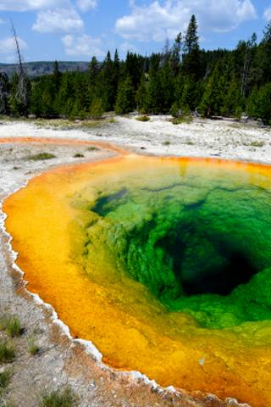
Thermophiles (> 50 ^{O}C)
Psychrophile (<25 ^{O}C)
Halophiles (Extreme salt condition)
Barophiles (High pressure)
Acidophiles (Extremely lower pH)
Alkaliphiles ( Extremely higher pH)
Hot Springs (100ºC)

Slide 11
Thermophiles
Thermophile is an extremophile that thrives at relatively high temperatures, between 41 and 122 °C (106 and 252 °F).
Thomas Brock and colleagues (late 1960 ’s) discovered first extremophile capable of growing over 70°C in Yellowstone’s volcanic hot springs
Simply thermophiles : 50–64 °C
Extreme thermophiles : 65–79 °C
Hyperthermophiles : 80 °C and beyond, but not < 50 °C.
Thermus aquaticus, the natural source of taq polymerase

Slide 12
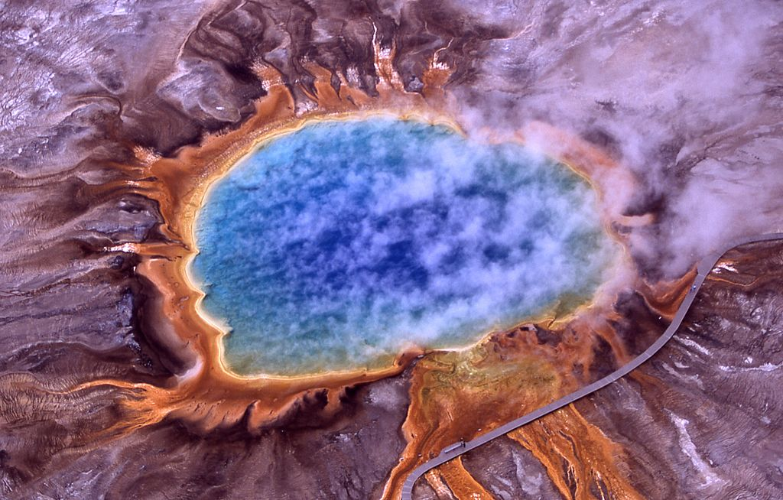
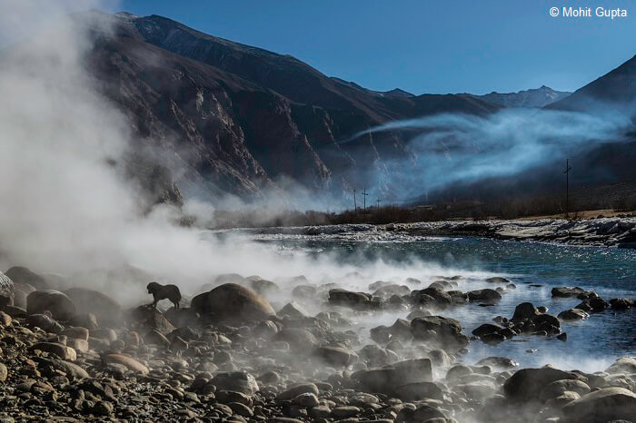
Places such as hot springs, deep-sea hydrothermal vents, areas associated with volcanic phenomena, hot water heaters, and even surfaces of compost heaps.
Hot springs of Ladakh, Jammu & Kashmir
Hot springs at Yellow Stone National Park, USA

Slide 13
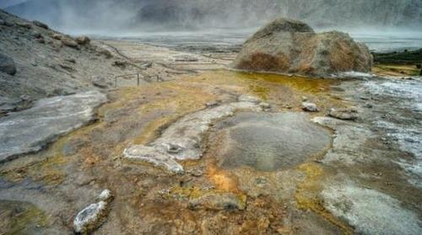
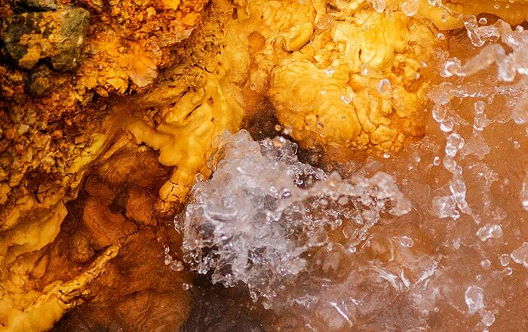
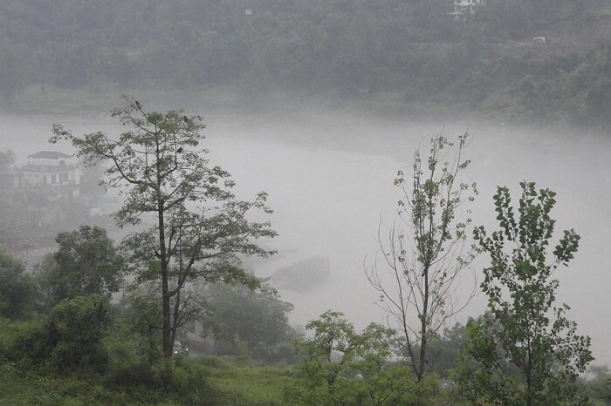
Nubra Valley, Jammu and Kashmir
Tapovan Hot Springs, Uttrakhand
Tattapani Hot Springs, Shimla

Slide 14
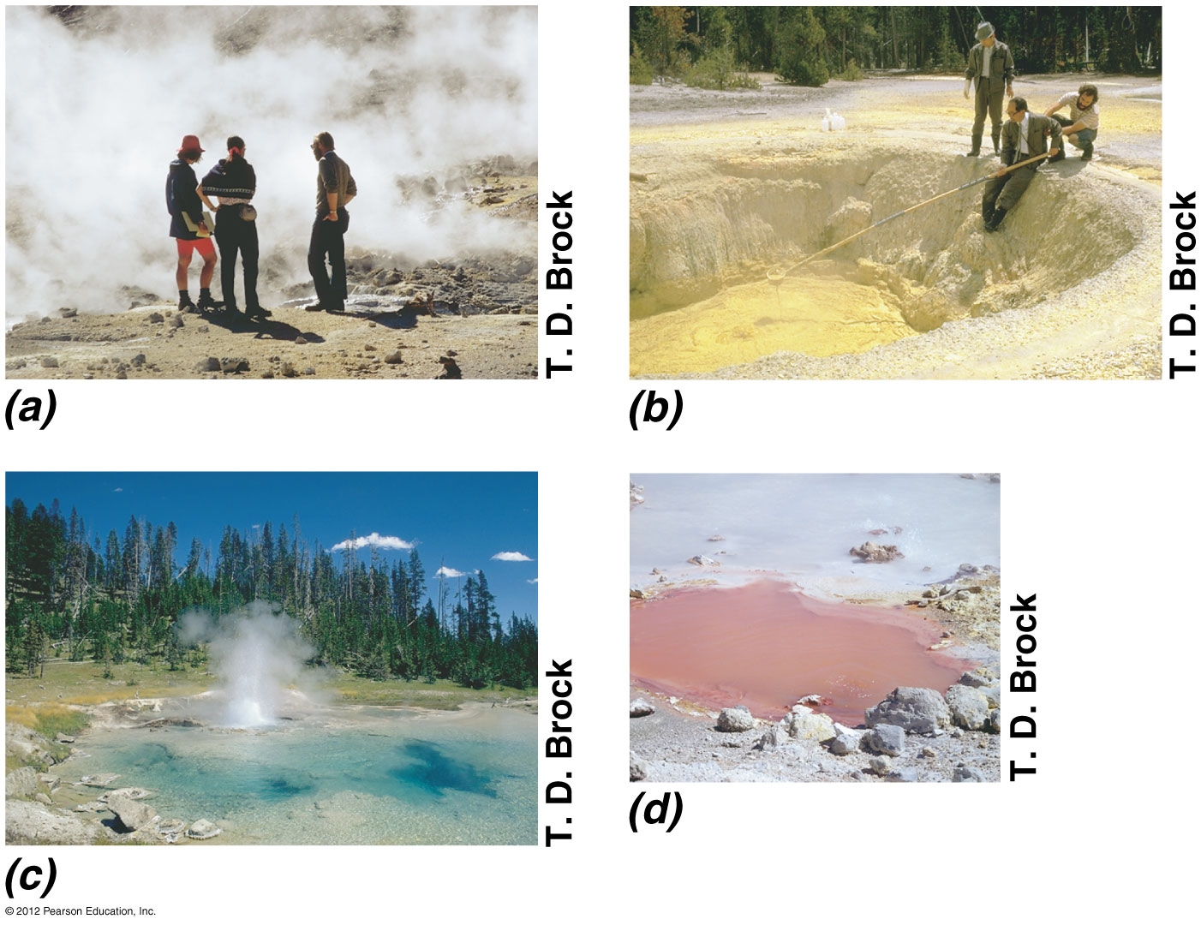

Slide 15
Hydrothermal vent system
Hydrothermal vent systems exist on the ocean floor, where there are lava flows underneath the ocean’s crust.
Sea water percolates down into the ocean crust, and, as it does so, picks up minerals dissolved into the ocean crust.
Two types of vents.
Warm vents 6-23 ⁰C and hot vents.
Hot vents emit at 270-380 ⁰C.

Slide 16
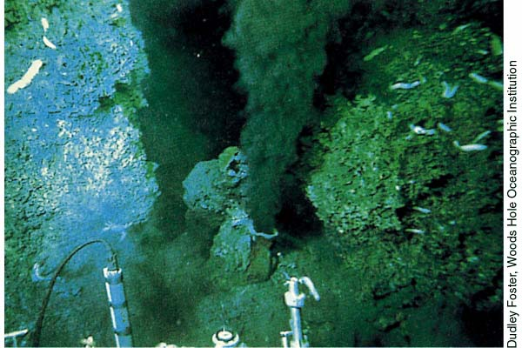

Slide 17
Psychrophiles
Psychrophiles or cryophiles (psychrophilic or cryophilic) are extremophilic organisms that are capable of growth and reproduction in low temperatures, ranging from −20 °C to +10 °C.
Psychrophile - 'cold-loving‘ (Greek)
They are present in polar ice, glaciers, snowfields and deep ocean waters.
Psychrophiles are protected from freezing and the expansion of ice by ice-induced desiccation and vitrification.

Slide 18
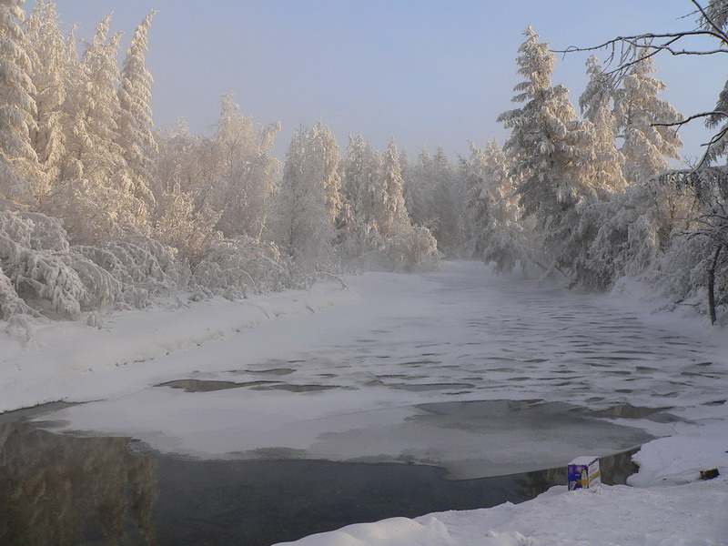
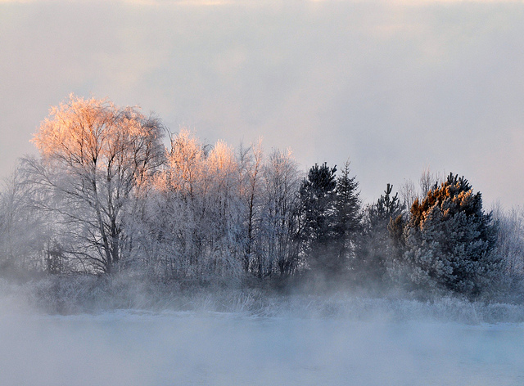
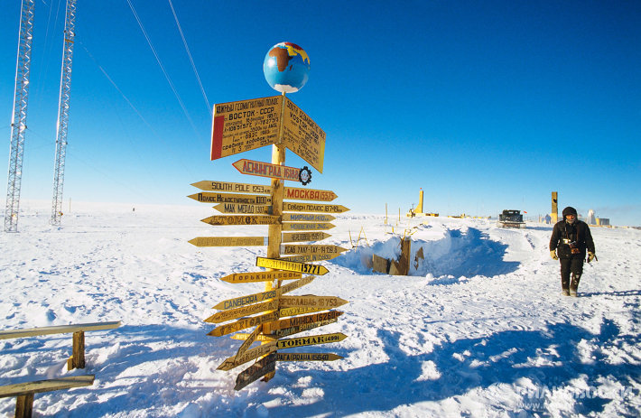
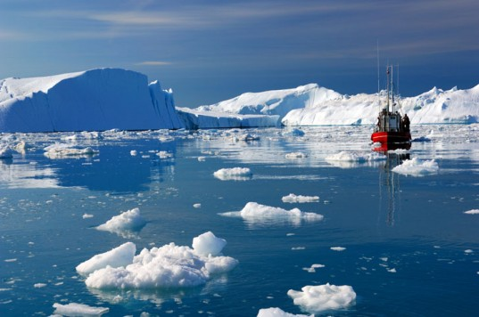
Verkhoyansk, Russia
Hell, Norway
Hell, Norway
Vostok Station, Antarctica
North Ice, Greenland

Slide 19
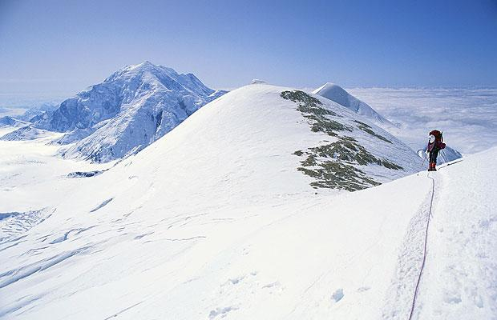
Denali, USA

Slide 20
Barophiles
A piezophile, also sometimes called a barophile, is an organism which thrives at high pressures
Piezophile – Pressure lover
Generally found on ocean floors, where pressure often exceeds 380 atm
Some have been found at the bottom of the Pacific Ocean where maximum pressure is roughly 117 MPa.
The high pressure experienced by these organisms can cause the normal fluid cell membrane to become waxy and relatively impermeable to nutrients.

Slide 21
For example, the Halomonas species Halomonas salaria requires a pressure of 1000 atm (100 MPa).
Most piezophiles grow in darkness and are usually very UV-sensitive
Piezophilic bacteria have a high proportion of fatty acids in their cytoplasmic membrane, which allows membranes to remain functional and keep from gelling at high pressures.

Slide 22
There are currently three classes or kinds of Barophiles:
1. Barotolerant - 100 to 200 atm
2. Barophilic - 200 to 500 atm
3. Extreme Barophiles - above 500 atm

Slide 23
Barotolerant
Able to survive at high temperatures
Can also exist in less extreme environments
They grow best in environments with standard atmospheric pressure, but can survive in high pressure environments
They grow at pressures from 100 - 450 ATM

Slide 24
Barophilic
The Barophilic organisms survive at pressure of 400-500 atm
Another version of the Barophilic is the extreme Barophilic and it can live in pressures greater than 500 atm
The extreme Barophilic can survive in the Marianas Trench, currently the deepest area underwater discovered by humans

Slide 25
Extreme Barophiles
Requires atleast 500 atm
Extreme barophile, endure at least 11,000 feet below sea level
Abundant on abyssal plains
Feed on amoebas

Slide 26
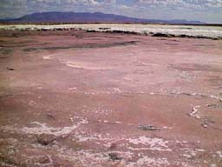
Halophiles
Halophiles are organisms that live in environments with extremely high salt concentrations
some extreme halophiles can live in solutions of 35 % salt. (seawater is only 3% salt!)
Halophile means “salt loving”
Based on optimal saline environments halophilic organisms can be grouped into three categories: extreme halophiles, moderate halophiles, and slightly halophilic or halotolerant organisms.

Slide 27
Halophiles
Domains: Archaea, Bacteria, smaller number of Eukarya (yeasts, algae and fungi); Halobacteriacea, Dunaliella salina
Environment: places where exposure to intense solar radiation leads to evaporation and concentration of NaCl to near- or even super-saturation; hypersaline bodies of water that exceed the 3.5 % salt of Earth’s oceans, Great Salt Lake in Utah, The Dead Sea.
Can be found in places with salt concentration as much as 5 times greater than that of the ocean (e.g. Great Salt Lakes, Mono Lake, Dead Sea, etc).

Slide 28
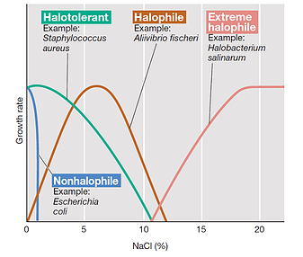

Slide 29
Halotolerant = Does not dependent on salts but can tolerate up to 15% salinity.
Extreme halophiles (often known as halobacteria) - unable to survive outside their high-salt native environment; primary inhabitants of salt lakes, where they tint the water and sediments with bright colors.

Slide 30
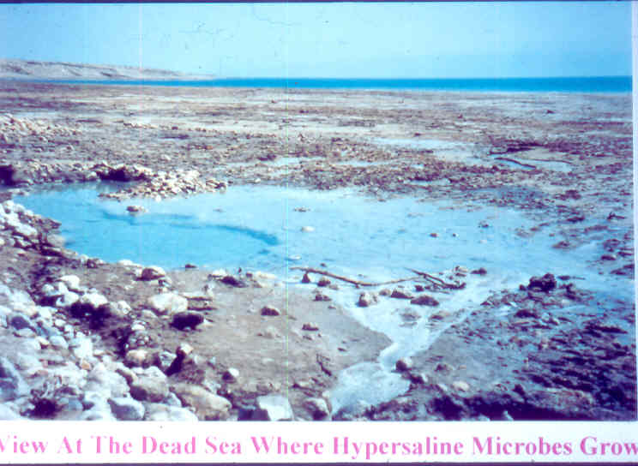
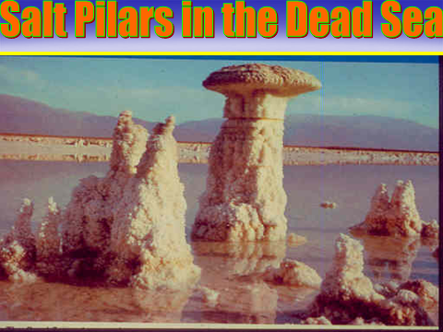
Dead Sea (Israel) where halophiles are growing

Slide 31
Extreme Halophiles
Extremely hypersaline environments are rare
Most found in hot, dry areas of world
Salt lakes can vary in ionic composition, selecting for different microbes
Great Salt Lake similar to concentrated seawater
Soda lakes are highly alkaline hypersaline environments
Have a requirement for high salt concentrations
Typically require at least 1.5 M (~9%) NaCl for growth
Found in solar salt evaporation ponds, salt lakes, and artificial saline habitats (i.e., salted foods)

Slide 32
Adaptations
Halophiles are found in salt lakes, salt marshes, subterranean salt deposits, dry soils, salted meats, hypersaline seas, and salt evaporation pools
The Red Sea was named after the halobacterium that turns the water red during massive blooms.
Water balance in extreme halophiles
Halophiles need to maintain osmotic balance
This is usually achieved by accumulation or synthesis of organic compatible solutes
Halobacterium species instead pump large amounts of K⁺ into the cell from the environment
Intracellular K⁺ concentration exceeds extracellular Na⁺ concentration and positive water balance is maintained

Slide 33
Archaea Bacteria
Archaea is a domain of prokaryotes that are genetically very different from bacteria and that have unique chemicals in their cell walls.
Although they are very small, prokaryotes can get energy and reproduce, and many can move.

Slide 34
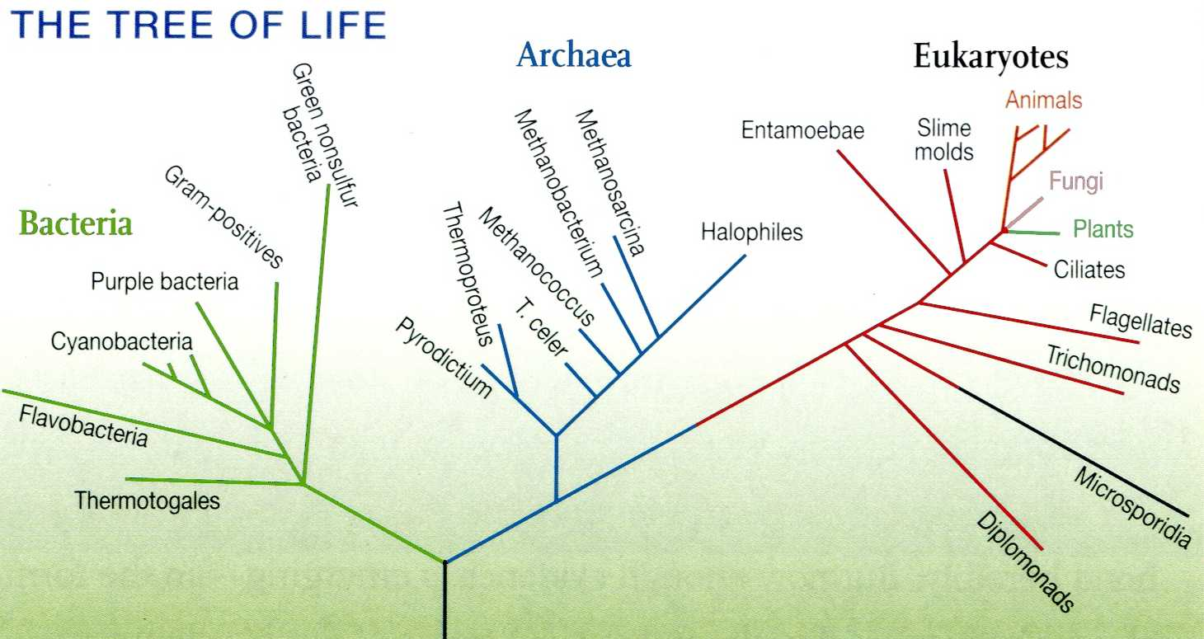

Slide 35
Characteristic features of Archaea
Archaea are organisms that have many unique molecular traits.
Prokaryotes, but their cell walls are chemically different from those of bacteria.
Some molecules in archaea are similar to molecules in eukaryotes. Some molecules in archaea are not found in other living things.
Often live where nothing else can, such as in hot springs and in extremely acidic or salty habitats.
Archaea flourish near deep-sea vents where no light reaches, and they can use sulfur to convert energy.

Slide 36
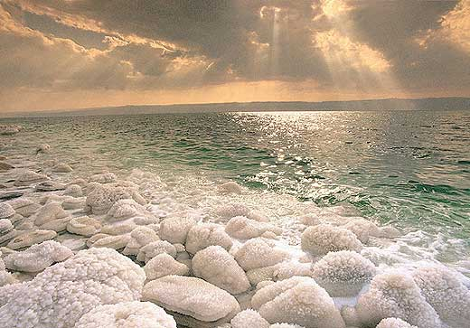
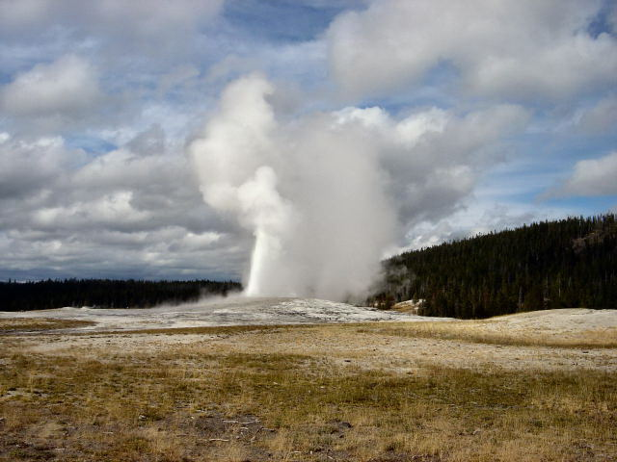
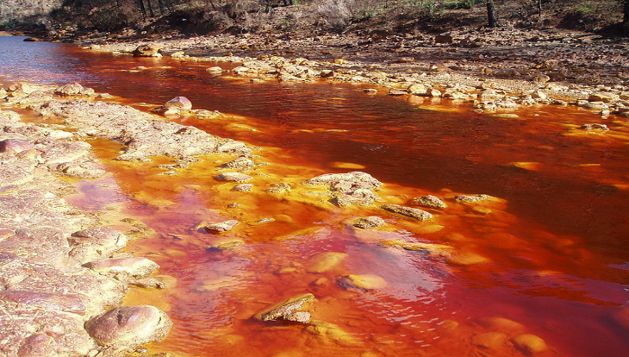
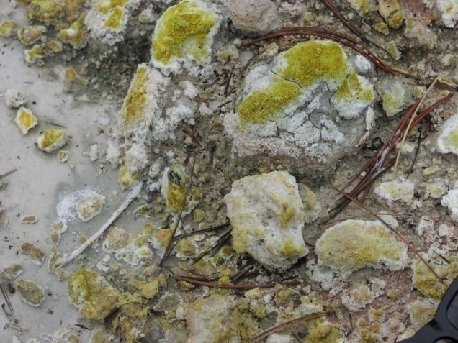
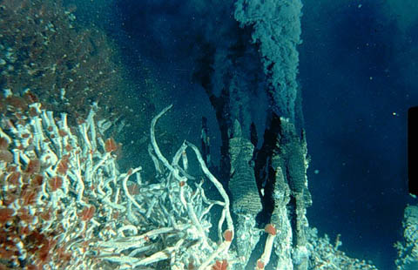

Slide 37
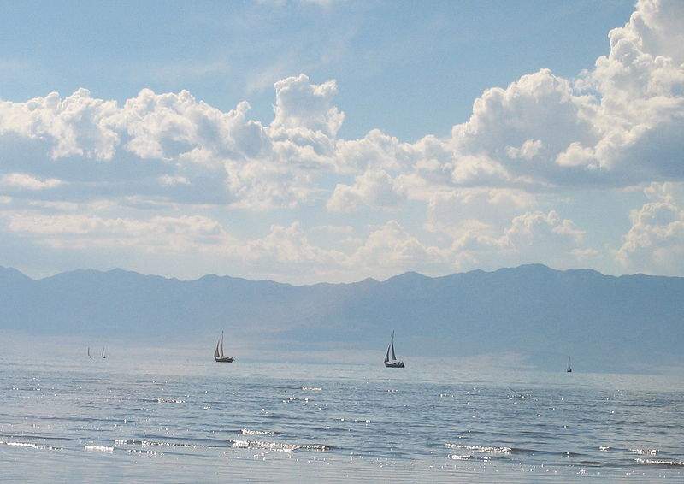
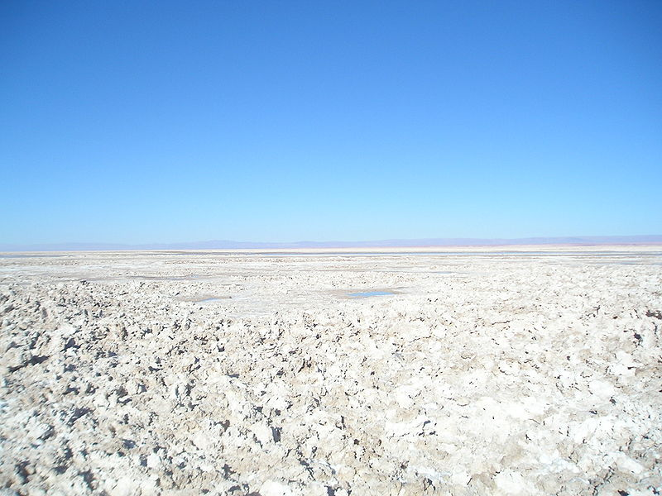
Great Salt Lake – USA
Salar de Atacama – Chile

Slide 38
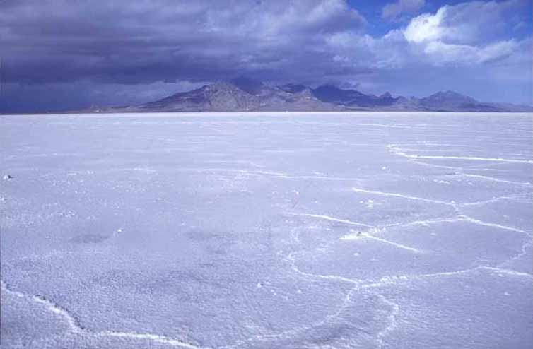
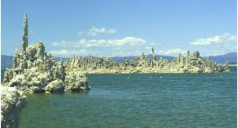
Bonneville Salt Flats – USA
Mono lake- USA

Slide 39
Astrobiology
Astrobiology is a branch of biology concerned with the origins, early evolution, distribution, and future of life in the universe.
Most astronomy-related astrobiology research falls into the category of extrasolar planet (exoplanet) detection, the hypothesis being that if life arose on Earth, then it could also arise on other planets with similar characteristics.

Slide 40
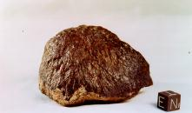
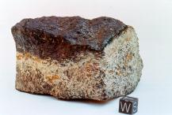
Life on martian?
Life On Mars??? No one knows for sure yet!
But in August 1996, scientists announced that they had extracted what they believed to be fossils of an unknown bacillus shaped microorganism from inside a meteorite from Mars found in Antarctica..
The meteorite left Mars 16 million years ago and landed in Antarctica 13 thousand years ago.
This may support the theory that life did or does still exist on Mars!

Slide 41
Surface of Mars
The Martian lithosphere consists of basalts, with a high amount of reduced minerals that, when in contact with oxidized fluids, offer conditions with high redox potentials that microorganisms can take advantage of to gain energy.
Abundances of radiogenic isotopes (K, U, Th) in Martian meteorites are similar to terrestrial igneous rocks, and it is most likely that radioactive decay provided a long-term heat source to sustain magmatism
Water on Mars in the form of ice is known to exist at the polar caps, in the ground, locally on the surface, and in the atmosphere
Thus the conditions, heat and water, that are required for hydrothermal activity exist on Mars.

Slide 42

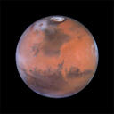
Surface Pressure: ~6 hPa
Mostly (96%)CO2, small amounts of
H20 vapor
CO2 and H20 polar ice
Lots of dust
Average T: -80F but warmer near equator in summer (70F)

Slide 43


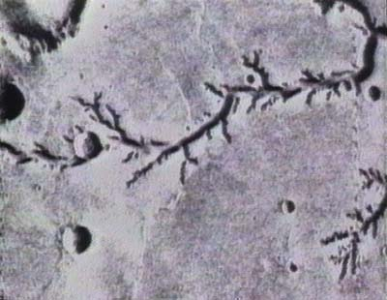
Trace of water on Mars

Slide 44
Life on Europa? Moon of Jupiter

Slide 45
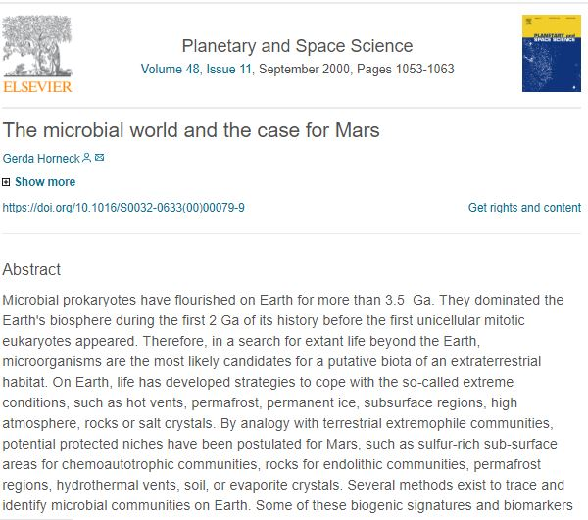

Slide 46
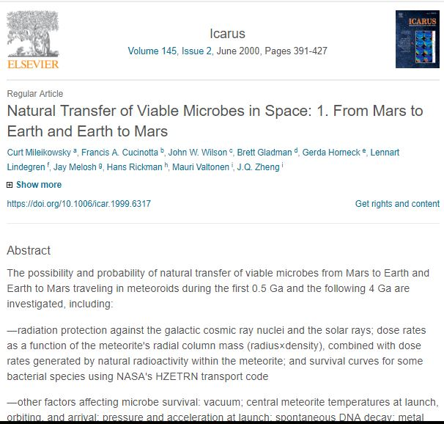

Slide 47
